Slide 1
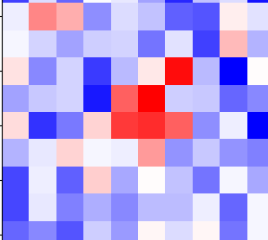
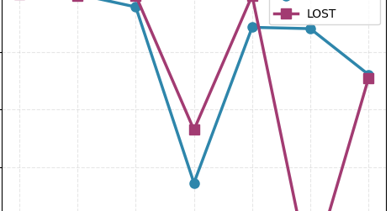
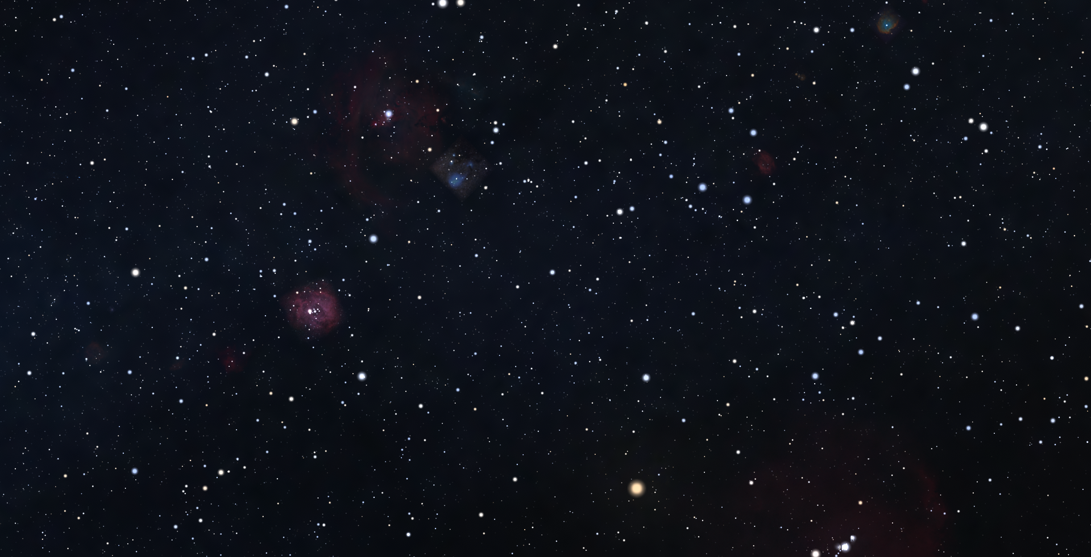
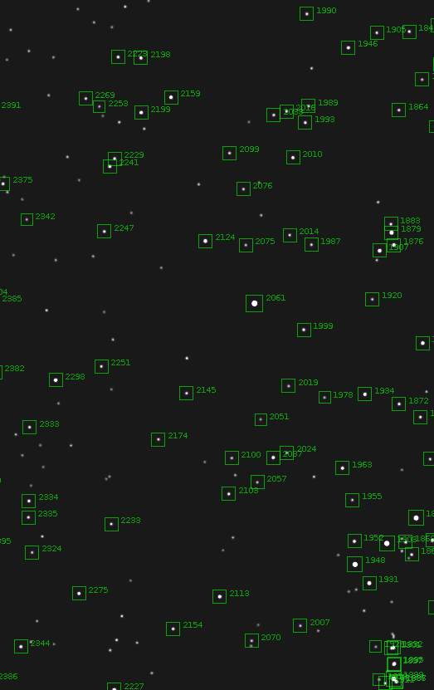
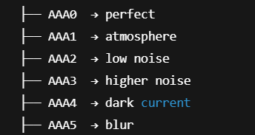
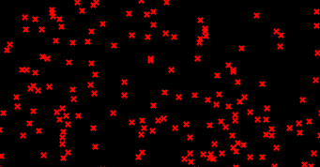
Star Detection and Centroid Localization
in highly electrical and luminous noise systems
Final Results
Centroid Localization
Task Overview:
Developing of an algorithm to overcome the star detection and centroid localization limitations of the open-source software LOST on a heterogeneous, noise-corrupted dataset.
LOST
Work Division:
The activities were divided into two distinct development areas, namely star detection and centroid localization with dataset generation, assigned respectively to Sara Francavilla and Andreea Pollastri.
Dataset Structure
Star Detection
Sara Francavilla – Andreea Pollastri

Slide 2
Star Detection and Centroid Localization
LOST: A general view
Standing for Low-cost Open-Source Star Tracker, it is an open-source software suite for star tracking, developed for use on small, low-power, low-cost satellites like CubeSats.
More specifically:
Generates synthetic star images
Detects stars in real and synthetic images using classic image segmentation and thresholding techniques
Computes Centroids position based on a weighted average of pixel intensities
Identifies them through an onboard catalog
Determines spacecraft attitude
Sara Francavilla – Andreea Pollastri

Slide 3
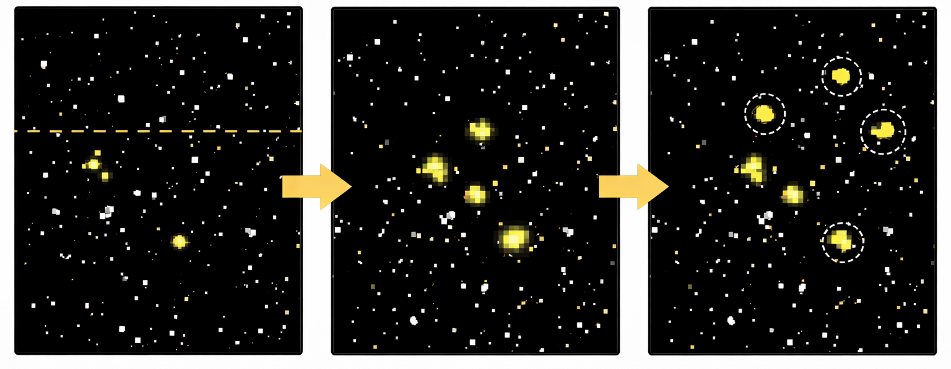
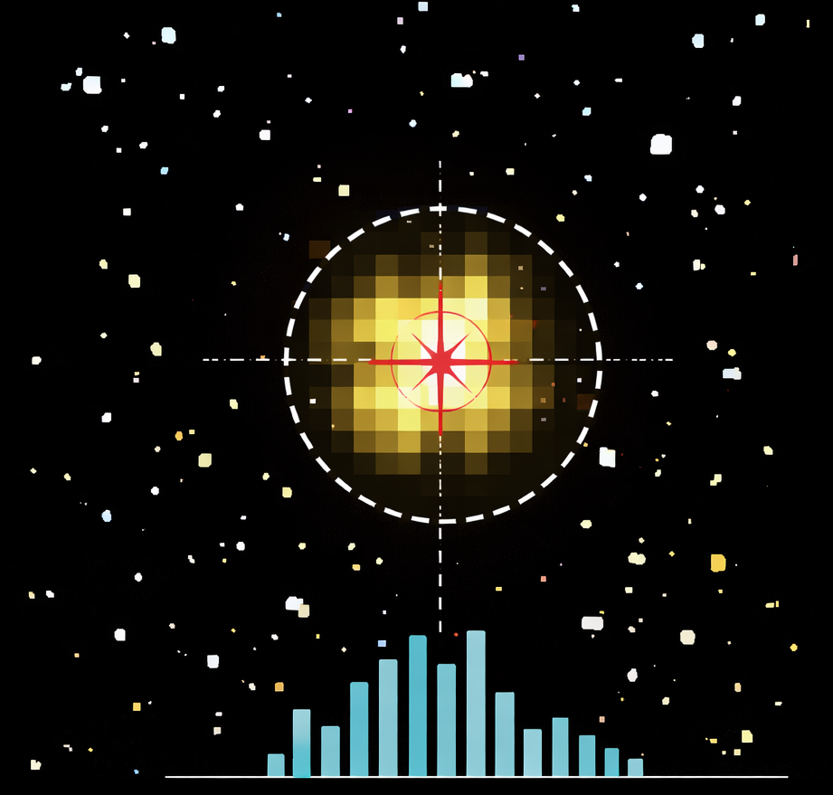
Star Detection and Centroid Localization
LOST: Approaches
Star Detection
Pixels with intensity above a fixed threshold are selected.
Adjacent bright pixels are grouped into connected components (blobs).
Each blob is treated as a star candidate.
Centroid localization
Uses a center-of-gravity (intensity-weighted average) over the detected star blob.
Assumes stars are compact and approximately symmetric.
Centroid accuracy depends strongly on the quality of star detection and on noise contamination within the blob.
Sara Francavilla – Andreea Pollastri

Slide 4
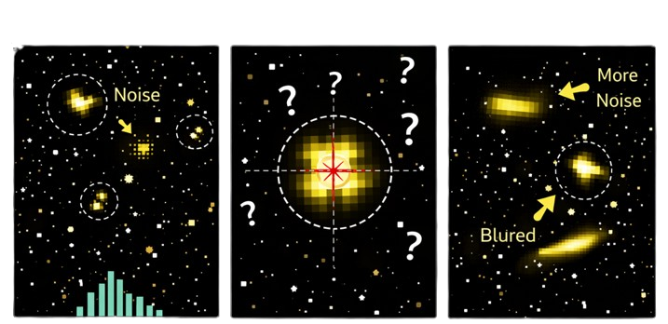
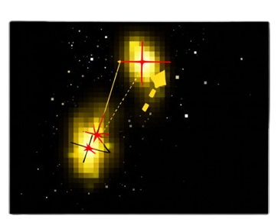
Star Detection and Centroid Localization
LOST: Limitations
Noise peaks often incorrectly detected as star candidates.
No Gaussian shape analysis.
Performance degrades in the presence of strong noise or elongated (stretched) stars.
Background noise and dark current bias the centroid toward brighter noise pixels.
Blurred or elongated stars produce systematic centroid shifts.
No explicit modeling of the star intensity distribution or noise statistics.
Sara Francavilla – Andreea Pollastri

Slide 5
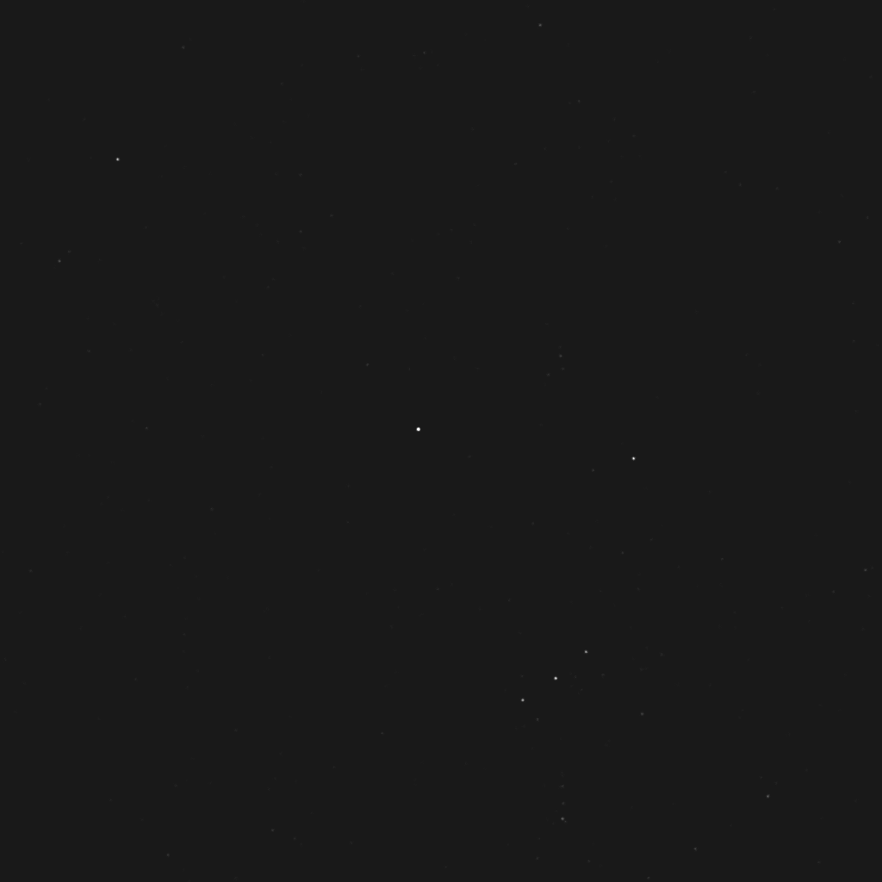
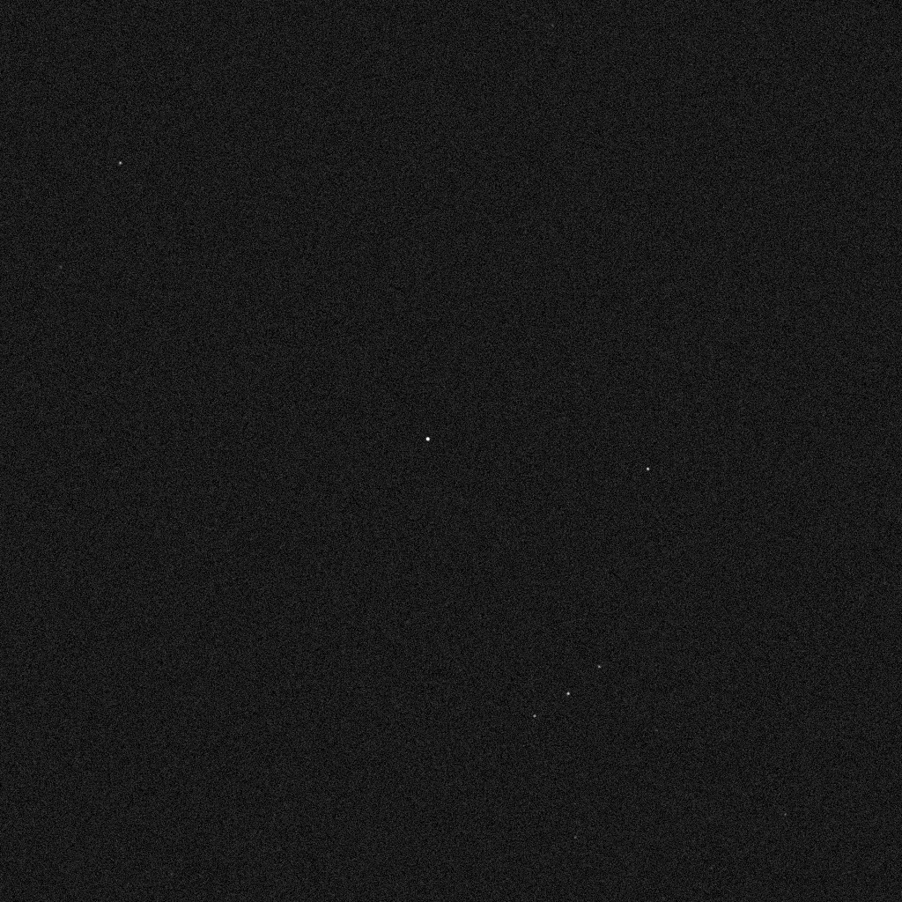
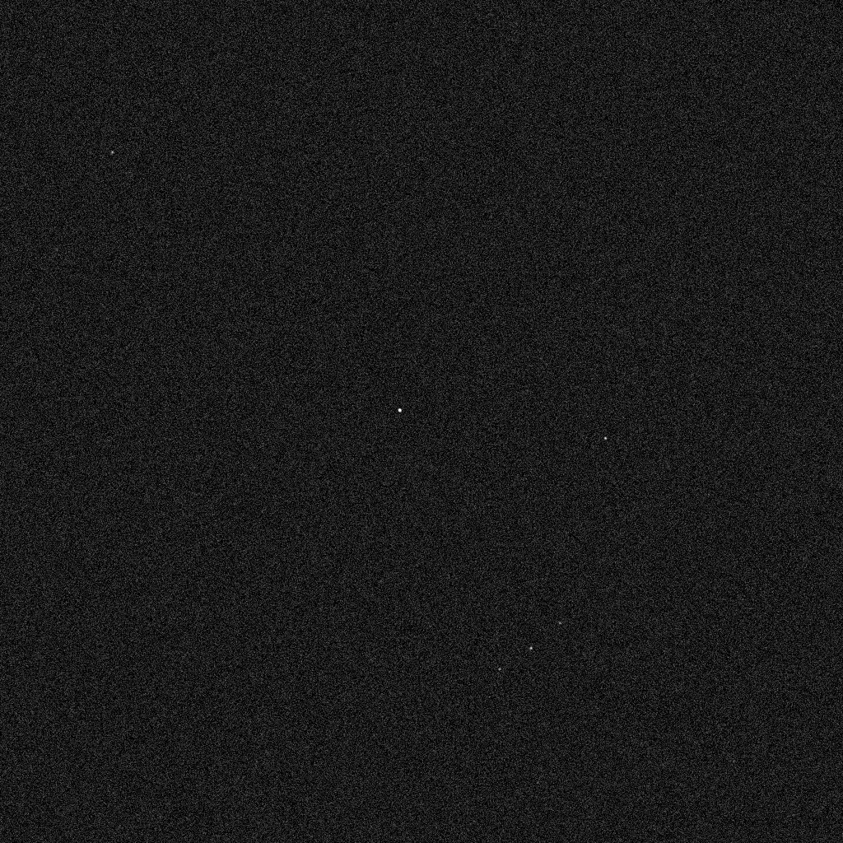
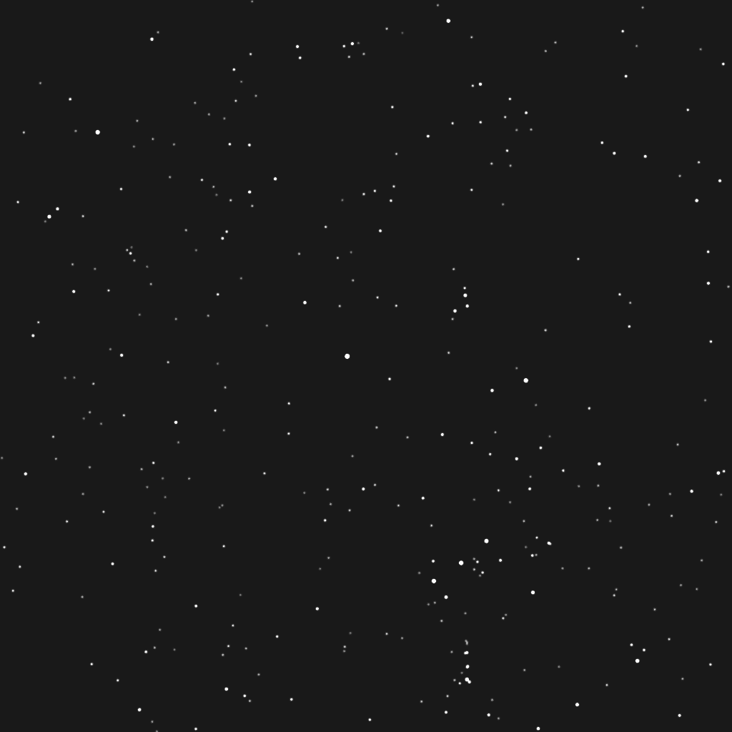
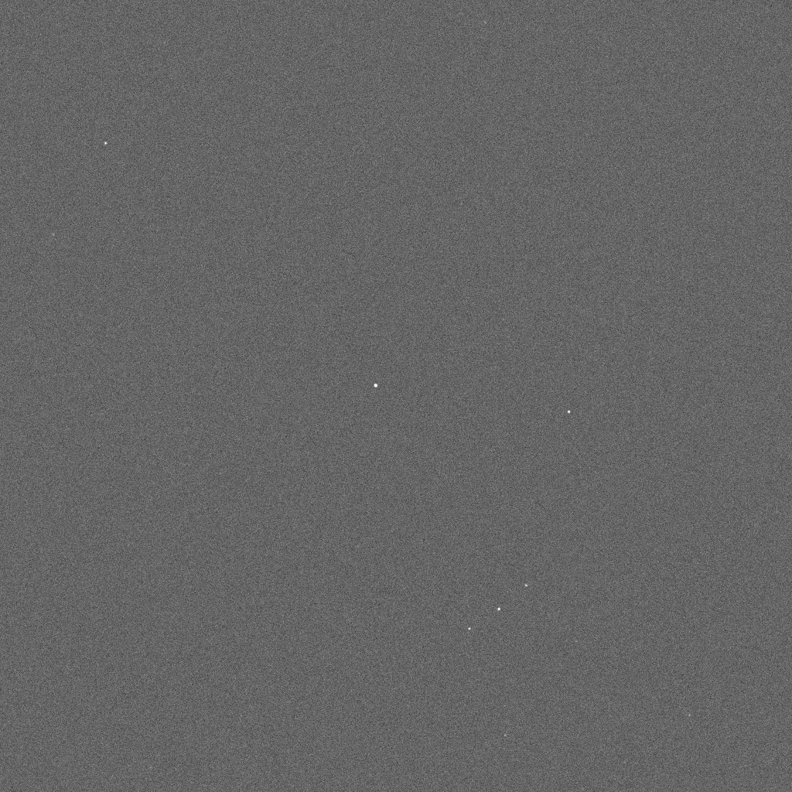
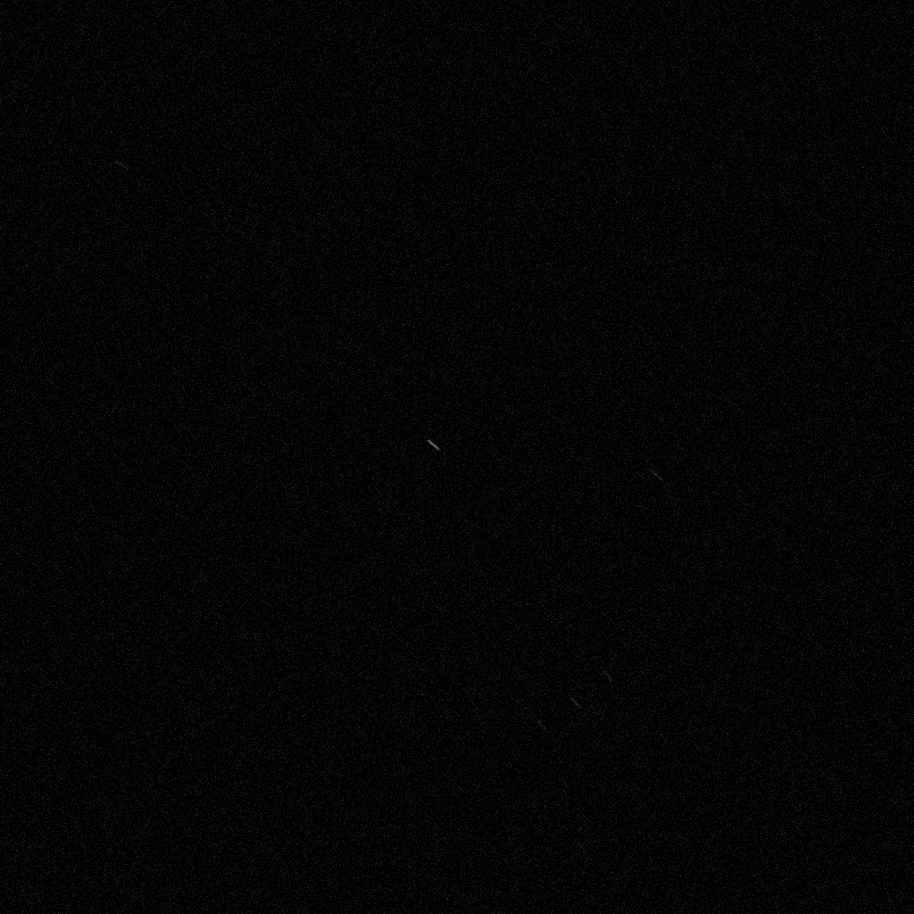
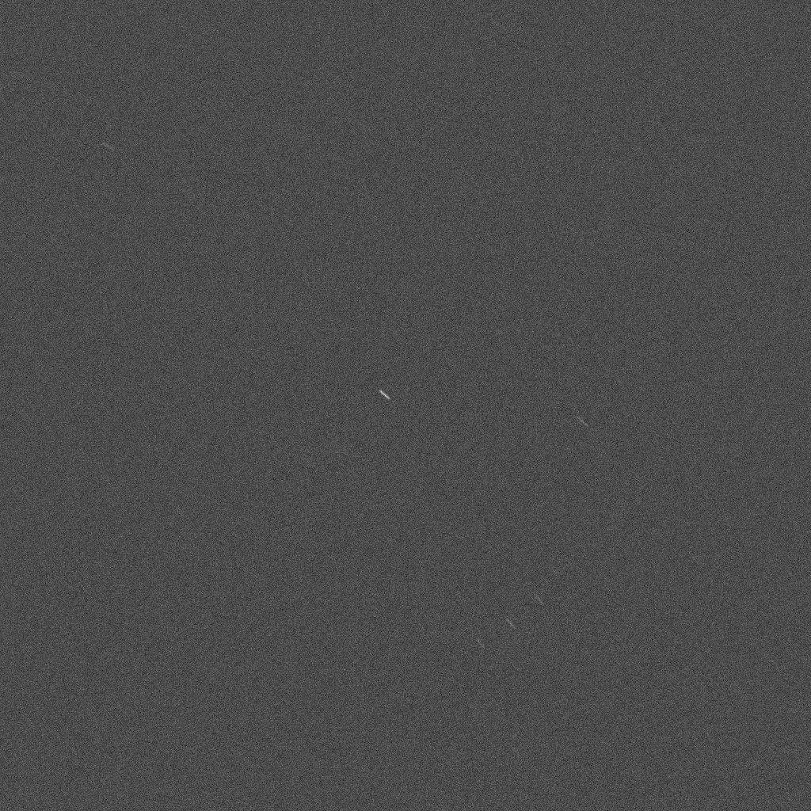
Star Detection and Centroid Localization
Star Detection: Study Images and Characteristics
Sara Francavilla – Andreea Pollastri

Slide 6
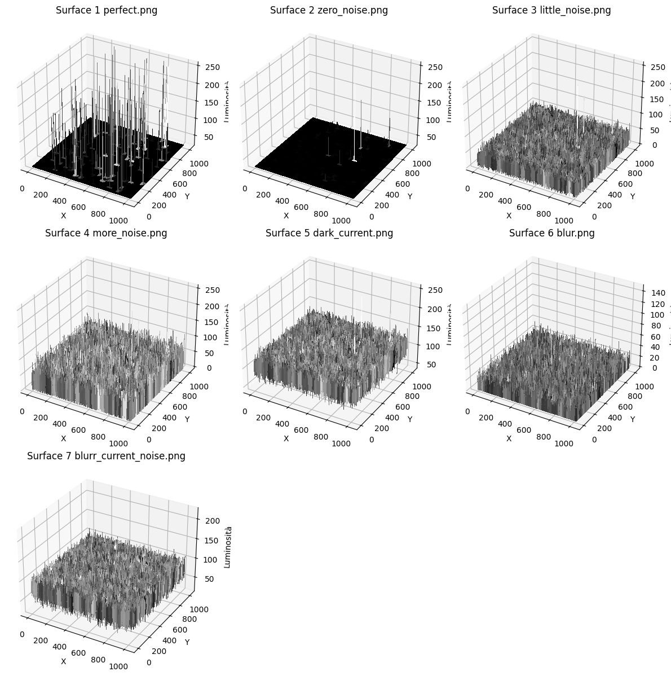
Star Detection and Centroid Localization
Star Detection: Study Images and Characteristics
Sara Francavilla – Andreea Pollastri

Slide 7
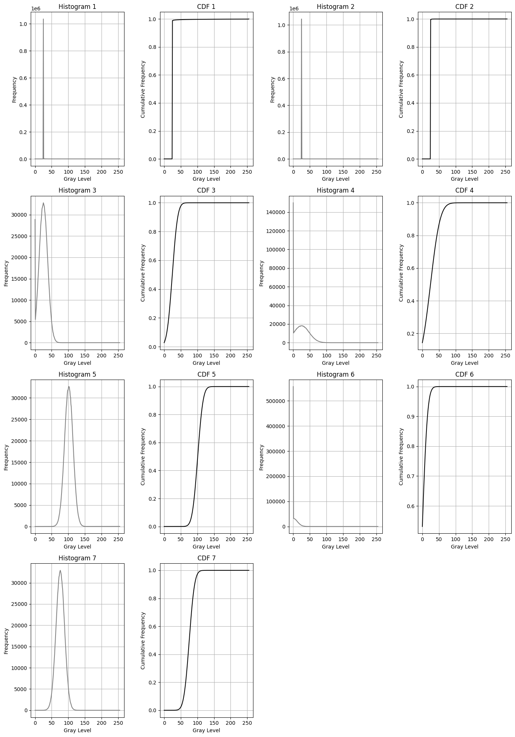
Star Detection and Centroid Localization
Star Detection: Setting Threshold
80% background
Ground Truth: 322
Image1 – 312 peaks
Image2 – 312 peaks
Image3 – 9021 peaks
Image4 – 8797 peaks
Image5 – 9041 peaks
Image6 – 9041 peaks
Image7 – 9050 peaks
Sara Francavilla – Andreea Pollastri

Slide 8
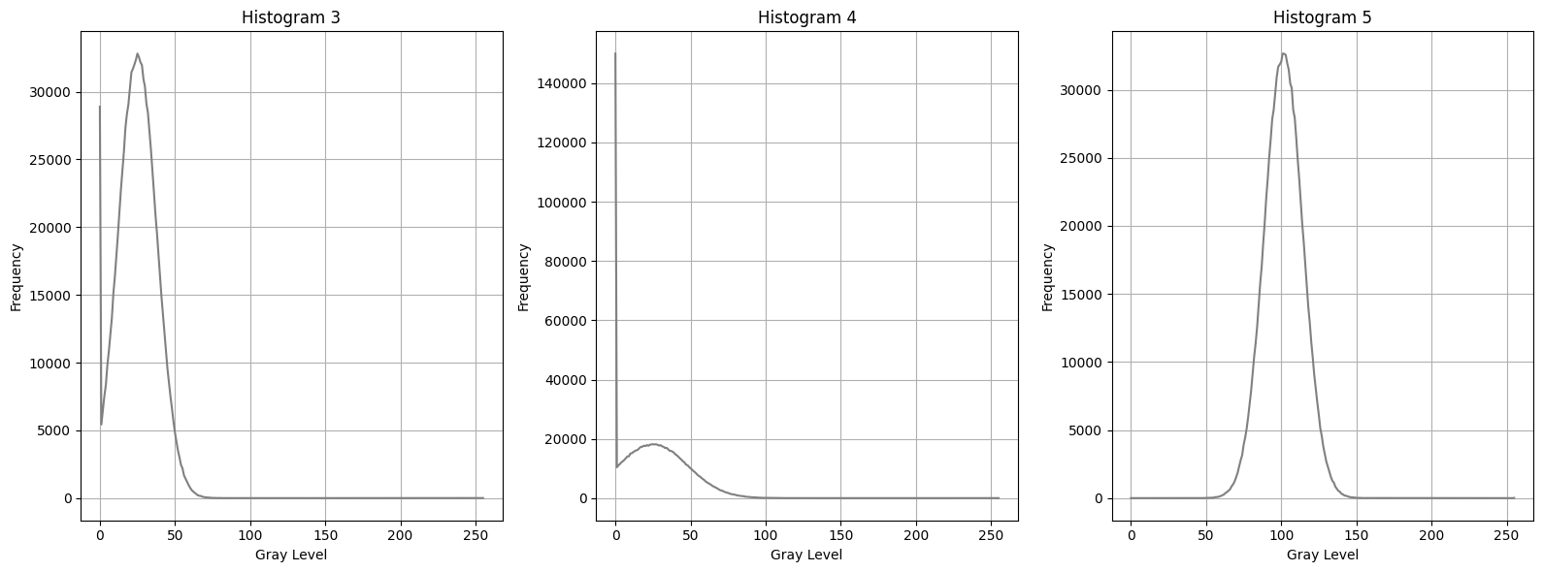
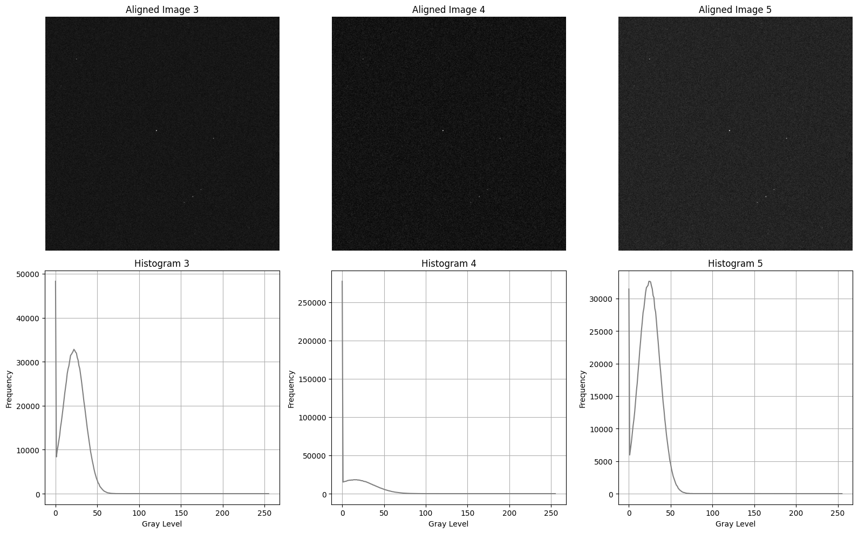
Star Detection and Centroid Localization
Star Detection: Studying Histograms
Aligning peak to perfect image peak
Sara Francavilla – Andreea Pollastri

Slide 9
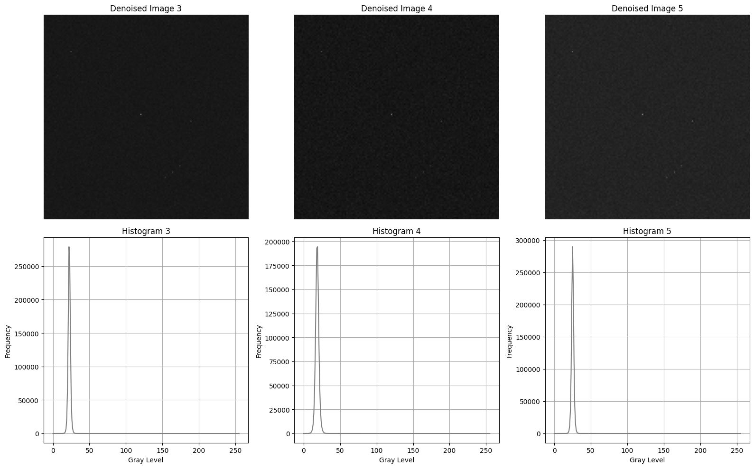

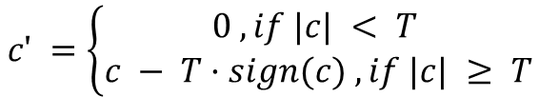
Star Detection and Centroid Localization
Star Detection: Studying Histograms
Soft thresholding
$$c′ =\left\{\begin{aligned}0 , if |c| < T \\ c − T·sign(c) , if |c| ≥ T\end{aligned}\right.$$
$$T = 3σ$$
Sara Francavilla – Andreea Pollastri

Slide 10
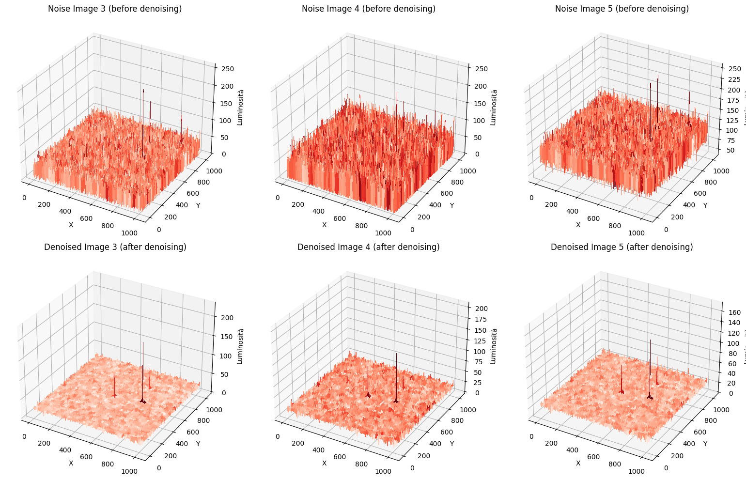
Star Detection and Centroid Localization
Star Detection: Denoised Results
Sara Francavilla – Andreea Pollastri

Slide 11
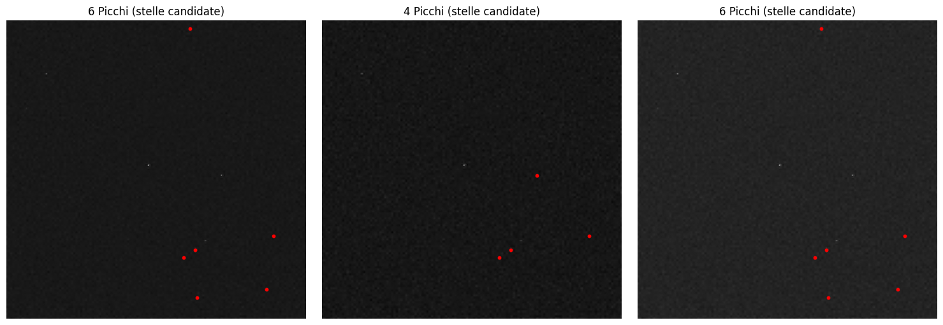
Star Detection and Centroid Localization
Star Detection: Static Nested Windows Function
def detect_stars_nested_base(img, A_size=3, B_size=7, th_mean=2, th_std=1):
Sara Francavilla – Andreea Pollastri

Slide 12
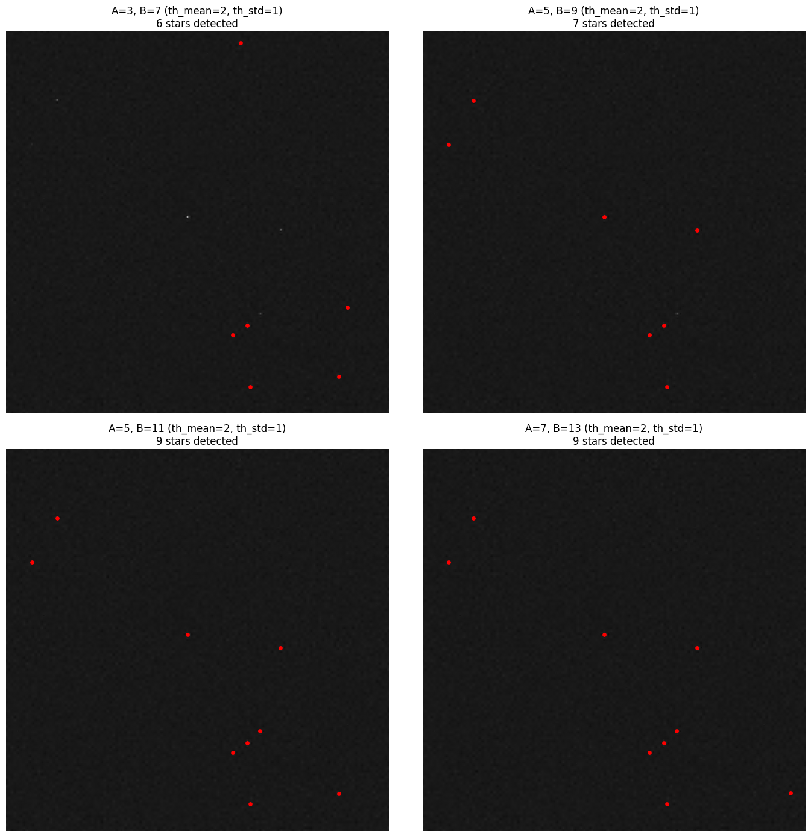
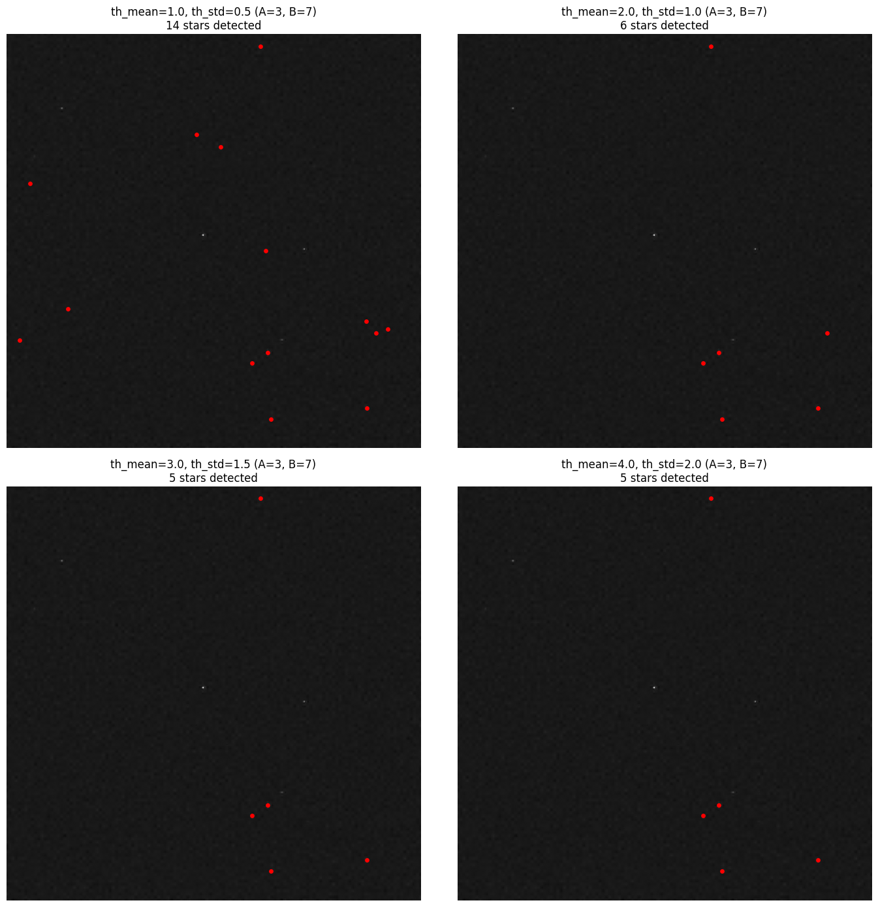
Star Detection and Centroid Localization
Star Detection: Studying Windows Parameters
Changing Windows Dimensions
Changing Mean and StD Thresholds
Sara Francavilla – Andreea Pollastri

Slide 13
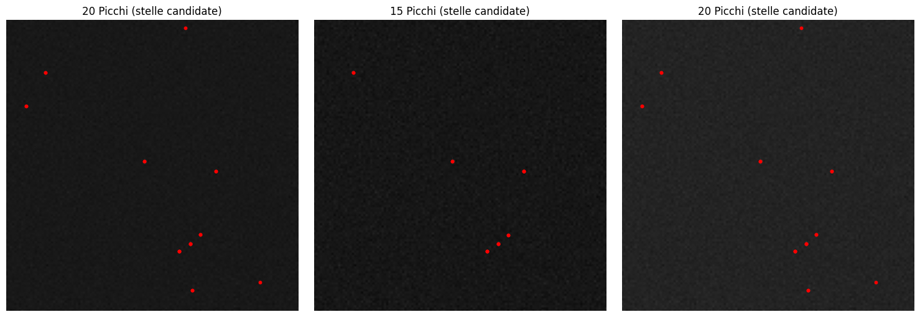
Star Detection and Centroid Localization
Star Detection: Multiscale Windows Function
def detect_stars_multiscale(img, A_sizes=[3,5,7], B_sizes=[7,11,15],
th_mean=4, th_std=3):
True Positives: 20
False Positives: 0
False Negatives: 302 Precision: 100.00%
Recall: 6.21%
F1-Score: 11.70%
True Positives: 15
False Positives: 0
False Negatives: 306 Precision: 100.00%
Recall: 4.67%
F1-Score: 8.93%
True Positives: 20
False Positives: 0
False Negatives: 302 Precision: 100.00%
Recall: 6.21%
F1-Score: 11.70%
Sara Francavilla – Andreea Pollastri

Slide 14
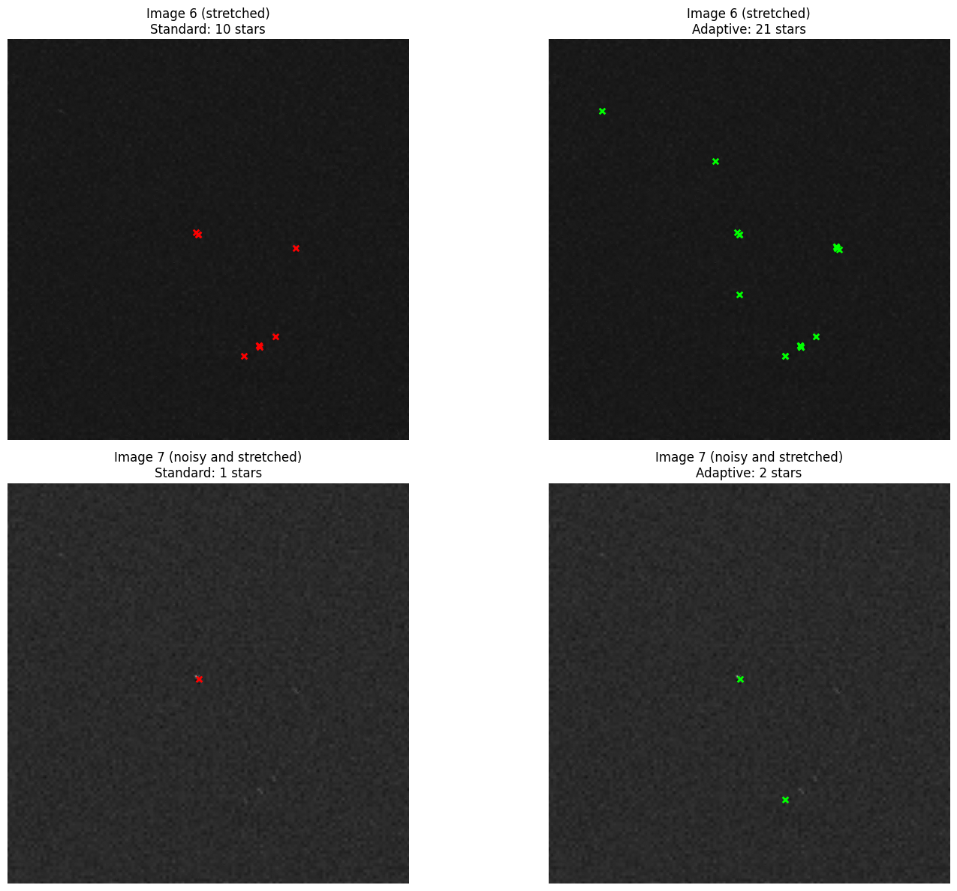
Star Detection and Centroid Localization
Star Detection: Adaptive Multiscale Function
def detect_stars_multiscale_adaptive(img, A_sizes=[3,5,7],sizes=[7,11,15],
th_mean=3, th_std=2, adapt_eccentricity=True,
ecc_threshold=0.4, scale_eccentricity_factor=0.5):
Image 6 (stretched):
Standard: 10 stars detected Adaptive: 21 stars detected
Improvement:
+11 stars (110.0%)
Image 7 (noisy and stretched): Standard: 1 stars detected Adaptive: 2 stars detected
Improvement:
+1 stars (100.0%)
Sara Francavilla – Andreea Pollastri

Slide 15
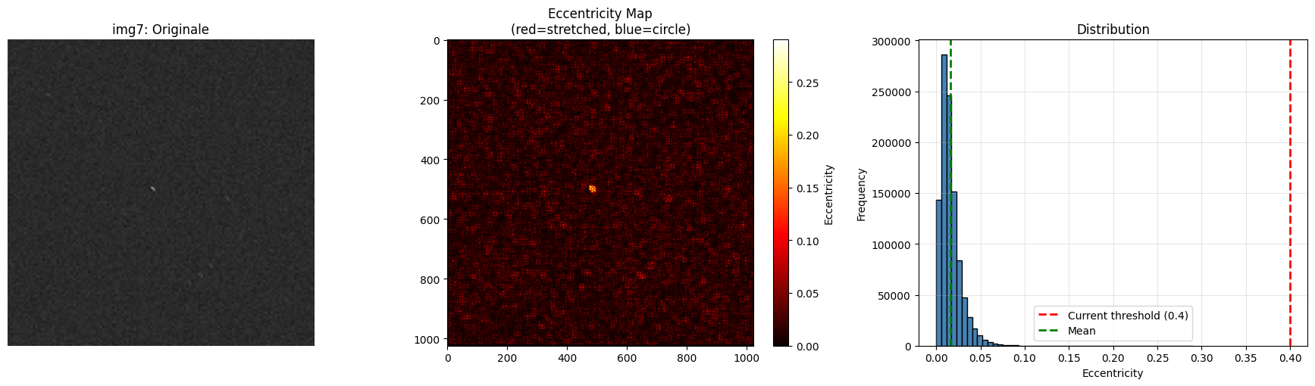
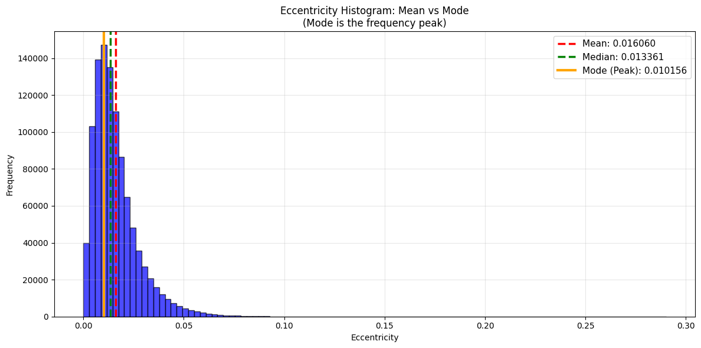
Star Detection and Centroid Localization
Star Detection: Improving Detection
Sara Francavilla – Andreea Pollastri

Slide 16
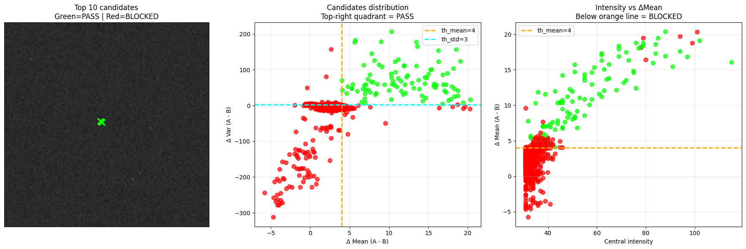
Star Detection and Centroid Localization
Star Detection: Improving Detection
Setting eccentricity threshold to mode (frequency peak)
Sara Francavilla – Andreea Pollastri

Slide 17
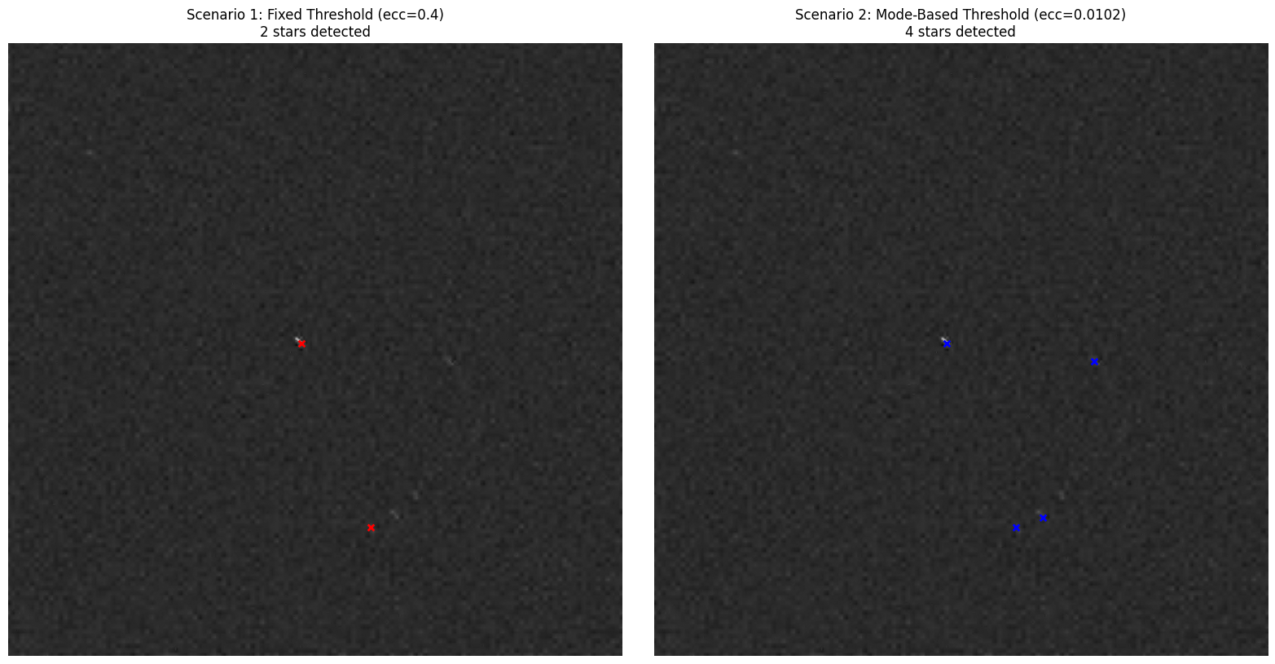
Star Detection and Centroid Localization
Star Detection: Improving Detection
True Positives: 17
False Positives: 4
False Negatives: 305
Precision: 80.95%
Recall: 5.28%
F1-Score: 9.91%
True Positives: 1
False Positives: 1
False Negatives: 311
Precision: 50.00%
Recall: 0.32%
F1-Score: 0.64%
Sara Francavilla – Andreea Pollastri

Slide 18
Star Detection and Centroid Localization
Star Detection: Final Detection Workflow
Estimate noise and blur
IF noisy → denoise
IF blurred → adaptive multiscale detection
ELSE → multiscale detection
ELSE
IF clean → local maxima
ELSE → adaptive multiscale detection
RETURN stars
Sara Francavilla – Andreea Pollastri

Slide 19
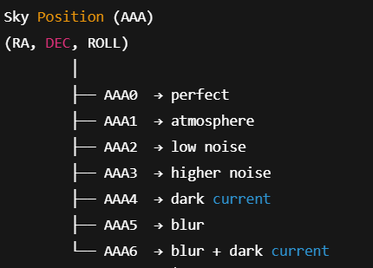
Star Detection and Centroid Localization
Dataset Structure
Composed by synthetic star-field images generated by varying sky position (RA, DEC, ROLL) and imaging conditions.
Stars are always visible to the naked eye while noise, blur, and dark current simulate realistic scenarios.
AAA0–AAA6 → same sky position, different noise levels
Up to 26³ unique sky positions
Ground-truth centroids stored in dataset/centroid/centroid_<IMAGE_ID>.csv
Sara Francavilla – Andreea Pollastri

Slide 20
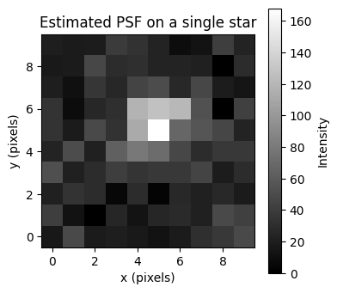
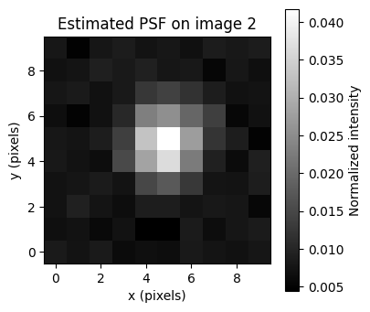
Star Detection and Centroid Localization
Centroid Localization
The spatial distribution of a star is described by the Point Spread Function
Sara Francavilla – Andreea Pollastri

Slide 21
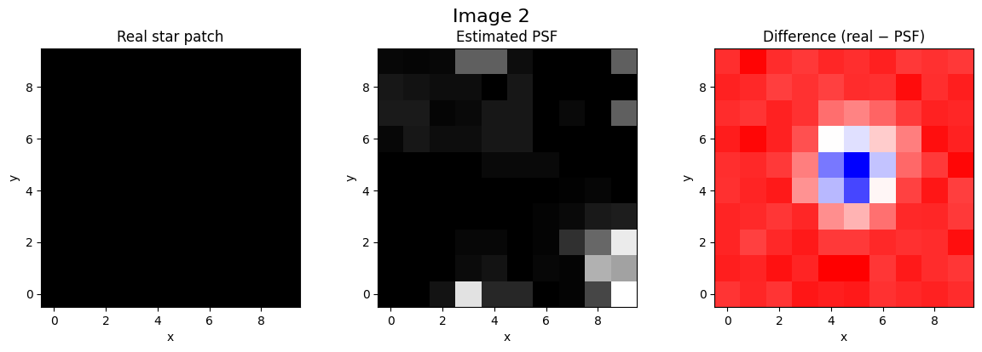
Star Detection and Centroid Localization
Centroid Localization
We compare a single real star patch extracted from the image with the estimated system PSF.
Image with atmospere:
Sara Francavilla – Andreea Pollastri

Slide 22

Star Detection and Centroid Localization
Centroid Localization
We compare a single real star patch extracted from the image with the estimated system PSF.
Image with noise:
Sara Francavilla – Andreea Pollastri

Slide 23
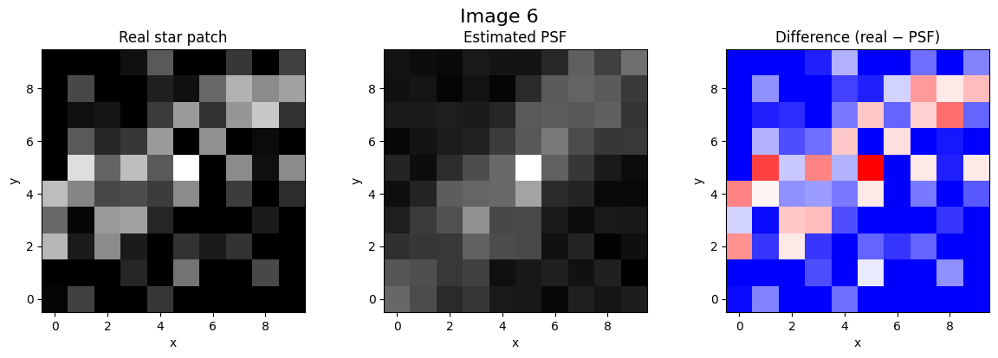
Star Detection and Centroid Localization
Centroid Localization
We compare a single real star patch extracted from the image with the estimated system PSF.
Image with blur:
Sara Francavilla – Andreea Pollastri

Slide 24
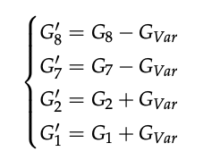
Star Detection and Centroid Localization
Centroid Localization:
Local Compensation
Technique used to reduce the effect of noise and local intensity variations on star centroid estimation.
Where G_Var is the variance of the neighborhood,
G8, G7 are the maximum and sub-maximum gray values,
G1, G2 are the minimum and sub-minimum gray values.
Sara Francavilla – Andreea Pollastri

Slide 25
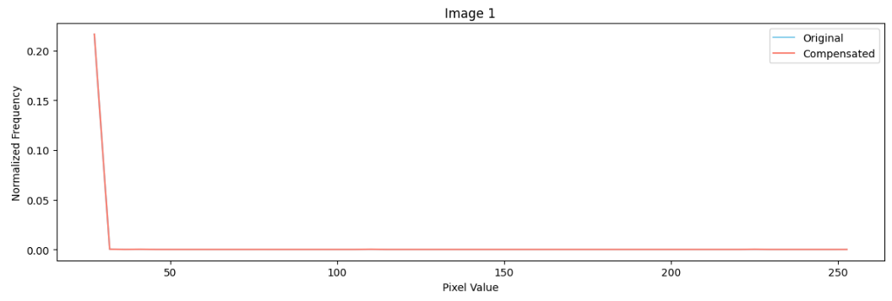
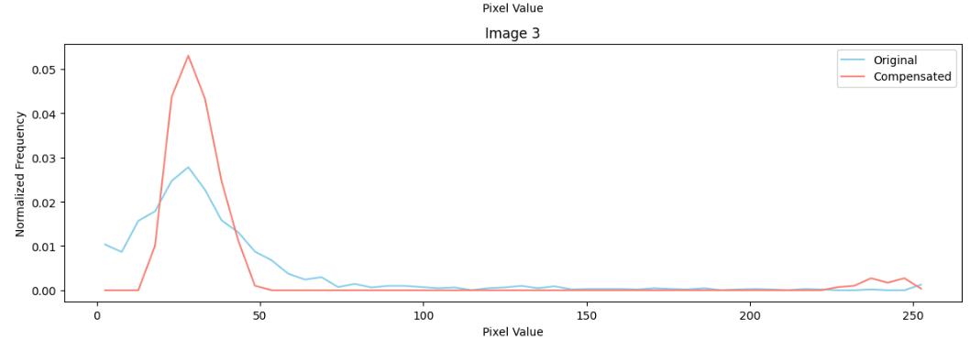
Star Detection and Centroid Localization
Centroid Localization:
Local Compensation
Sara Francavilla – Andreea Pollastri

Slide 26
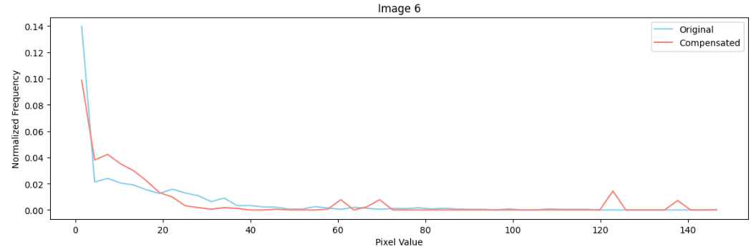
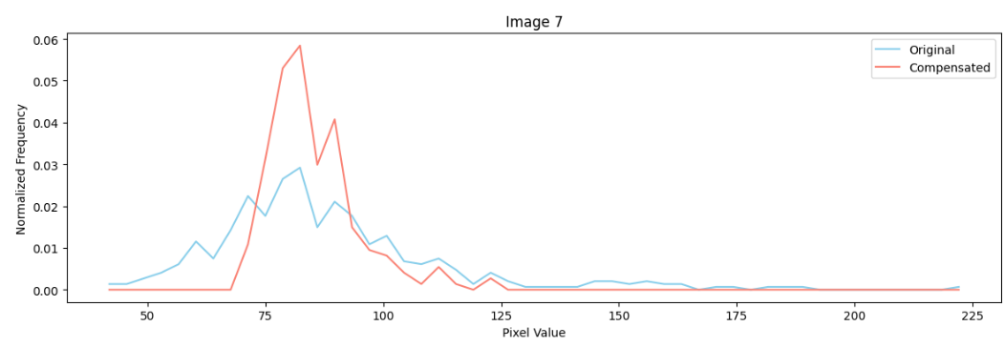
Star Detection and Centroid Localization
Centroid Localization:
Local Compensation
Sara Francavilla – Andreea Pollastri

Slide 27

Star Detection and Centroid Localization
Centroid Localization:
Mathematically
To estimate the star center from the image, we use a weighted centroid approach with a threshold.
weights = patch – T
xc = np.sum((xx + x1) * weights) / np.sum(weights)
yc = np.sum((yy + y1) * weights) / np.sum(weights)
Sara Francavilla – Andreea Pollastri

Slide 28
Star Detection and Centroid Localization
Centroid Localization:
Algorithm
patches → extract_star_patches(size=window)
FOR every patch
patch → energy_compensation
T → patch.min() + percent * (patch.max() - patch.min())
c → threshold_centroid
centroid.append(c)
Hyperparameters:
percent = 0.2
window = 5
Sara Francavilla – Andreea Pollastri

Slide 29
Star Detection and Centroid Localization
Centroid Localization:
Algorithm error - 3px
Image | TP | FP | FN | Precision | Recall | Stars
0 | 110 | 188 | 83 | 0.3691 | 0.5699 | 298
1 | 164 | 133 | 29 | 0.5522 | 0.8497 | 297
2 | 9 | 13 | 184 | 0.4091 | 0.0466 | 22
3 | 7 | 18 | 186 | 0.2800 | 0.0363 | 25
4 | 9 | 10 | 184 | 0.4737 | 0.0466 | 19
5 | 4 | 17 | 189 | 0.1905 | 0.0207 | 21
6 | 1 | 3 | 192 | 0.2500 | 0.0052 | 4
Sara Francavilla – Andreea Pollastri

Slide 30
Star Detection and Centroid Localization
Centroid Localization:
Algorithm Duplicated Coordinates
patches → extract_star_patches(size=window)
FOR patch in patches
patch → energy_compensation
patch → extract_patch(size=window_s)
T → patch.min() + percent * (patch.max() - patch.min())
c → threshold_centroid
centroid.append(c)
FOR i in centroid
IF i in used CONTINUE
cluster = [i]
FOR j in centroid
IF j not in used AND distance(i, j) < 1.5
cluster.append(j)
final.append(mean(cluster))
Hyperparameters:
window = 5
window small = 3
percent small = 0.8
Sara Francavilla – Andreea Pollastri

Slide 31
Star Detection and Centroid Localization
Centroid Localization:
Algorithm error - 3px
Image |  | TP | FP | FN | Precision | Recall | Stars
0 |  | 120 | 178 | 73 | 0.4027 | 0.6218 | 298
1 |  | 171 | 126 | 22 | 0.5758 | 0.8860 | 297
2 |  | 10 | 0 | 183 | 1.0000 | 0.0518 | 10
3 |  | 8 | 7 | 185 | 0.5333 | 0.0415 | 15
4 |  | 9 | 1 | 184 | 0.9000 | 0.0466 | 10
5 |  | 4 | 8 | 189 | 0.3333 | 0.0207 | 12
6 |  | 2 | 2 | 191 | 0.5000 | 0.0104 | 4
The number of stars decreases after the consolidation step.
Sara Francavilla – Andreea Pollastri

Slide 32
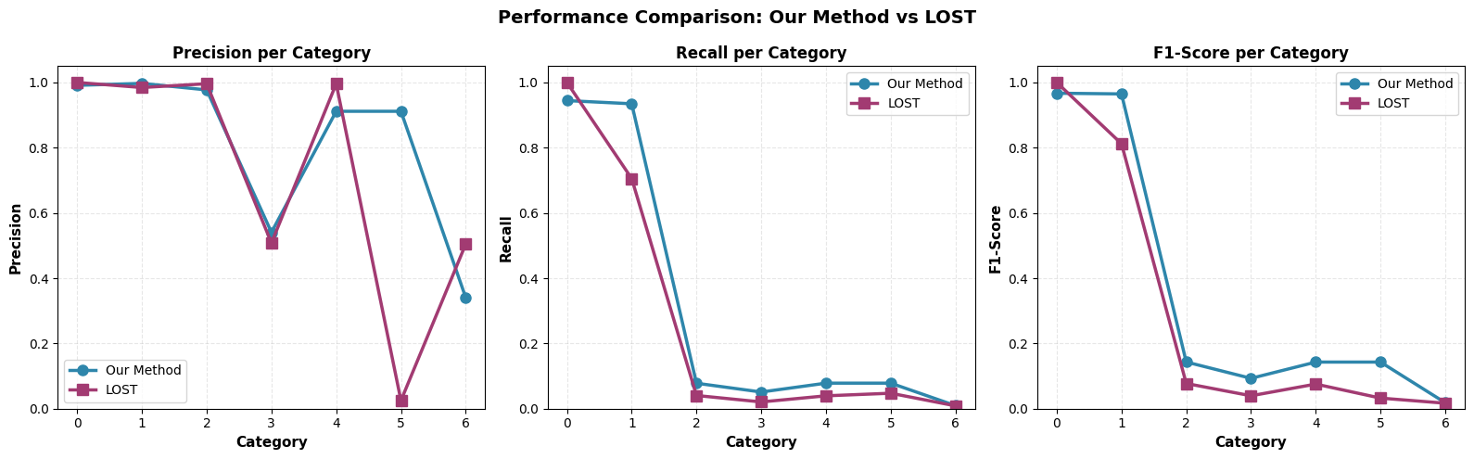
Star Detection and Centroid Localization
Final Results: Star Detection
Categories 0–2 (clean / mild noise):
Both methods achieve high precision.
LOST performs optimally in ideal conditions.
Categories 3–4 (high noise, dark current):
LOST precision degrades due to increasing false positives.
The proposed method maintains precision >90%.
Category 5 (blur):
LOST fails dramatically (precision 2.49%) due to noise and blur peaks.
The proposed method remains stable and reliable.
Category 6 (blur + dark current):
Proposed method continues to control false detections.
LOST shows unstable behavior.
Sara Francavilla – Andreea Pollastri

Slide 33
Star Detection and Centroid Localization
Final Results: Star Detection
Recall decreases for both methods as noise increases.
Degradation is strongest in severely noisy and blurred categories.
The proposed method achieves comparable or slightly higher recall than LOST in most classes.
Sara Francavilla – Andreea Pollastri

Slide 34
Star Detection and Centroid Localization
Final Results: Star Detection
F1-score drops in highly degraded images due to recall loss.
Despite this, the proposed method consistently achieves higher F1-scores than LOST across most categories.
Sara Francavilla – Andreea Pollastri

Slide 35

Star Detection and Centroid Localization
Final Results: Centroid Localization
Categories 0–1 (ideal / low noise):
LOST slightly outperforms due to its role in image generation.
Categories 2–4 (moderate noise, dark current):
The proposed method achieves comparable or higher numbers of correct matches.
Category 5 (blur):
LOST reports an artificially high number of matches caused by over-detection.
The proposed method remains consistent and realistic.
Category 6 (blur + dark current):
Both methods show similarly low performance.
Sara Francavilla – Andreea Pollastri

Slide 36
Star Detection and Centroid Localization
Final Results: Centroid Localization
Category 0 (noise-free):
LOST achieves perfect localization.
Noisy categories (1–6):
Match ratio decreases for both methods as star visibility degrades.
The proposed method generally achieves equal or higher match ratios in noisy conditions.
Sara Francavilla – Andreea Pollastri

Slide 37
Star Detection and Centroid Localization
Final Results: Centroid Localization
Measures the proportion of correct centroids among detected stars.
Across most categories:
The proposed method shows higher and more stable relative ratios.
Category 5 (blur):
LOST suffers a strong drop due to excessive false detections.
Sara Francavilla – Andreea Pollastri

Slide 38
Star Detection and Centroid Localization
Final Results
Centroid Localization
Thanks
LOST
Dataset Structure
Star Detection
Sara Francavilla – Andreea Pollastri

